Slide 1
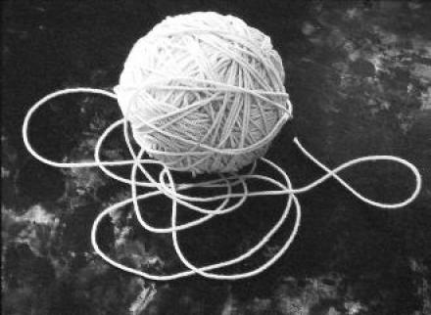
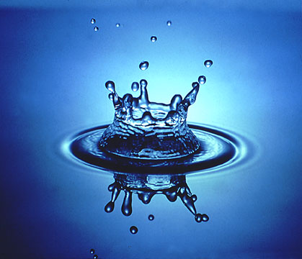
Strings and Things: The Discovery of the strongly interacting Quark Gluon Plasma at the Relativistic Heavy Ion Collider
Richard Seto
UCR
Teachers Academy
6/25/2012

Slide 2
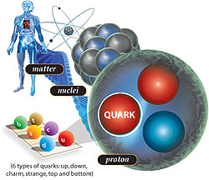
What are we made of?
Quarks

Slide 3
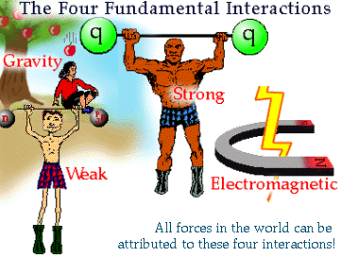

Slide 4
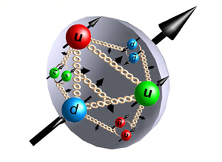
What are we made of?
Quarks
And Gluons

Slide 5
What happens if you cook the nucleus?
Why ask the question?
  Large scale QCD system
  we have NO IDEA what it is really like
    Properties (dynamical – lattice can calculate static only)
      viscosity
      thermal conductivity
      ???
  innovations in both experiments and theory
    Strings
    hydro models (3d viscous relativistic)
    initial state – new non-perturbative QCD methods

Slide 6
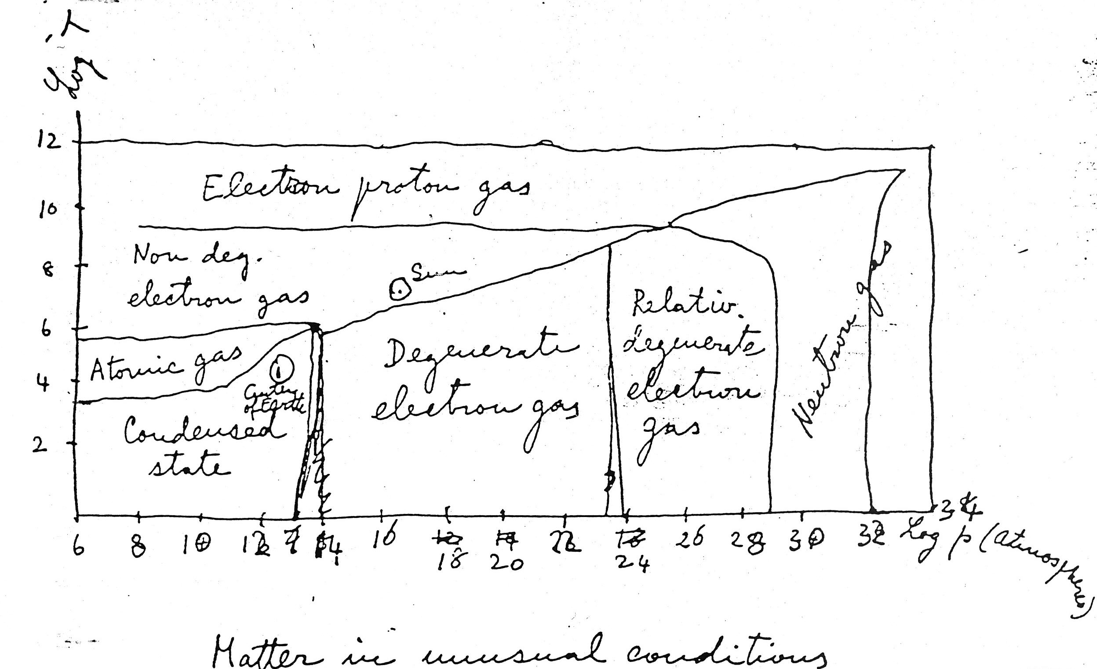
Fermi asked the question
From Fermi notes on Thermodynamics
RHIC

Slide 7
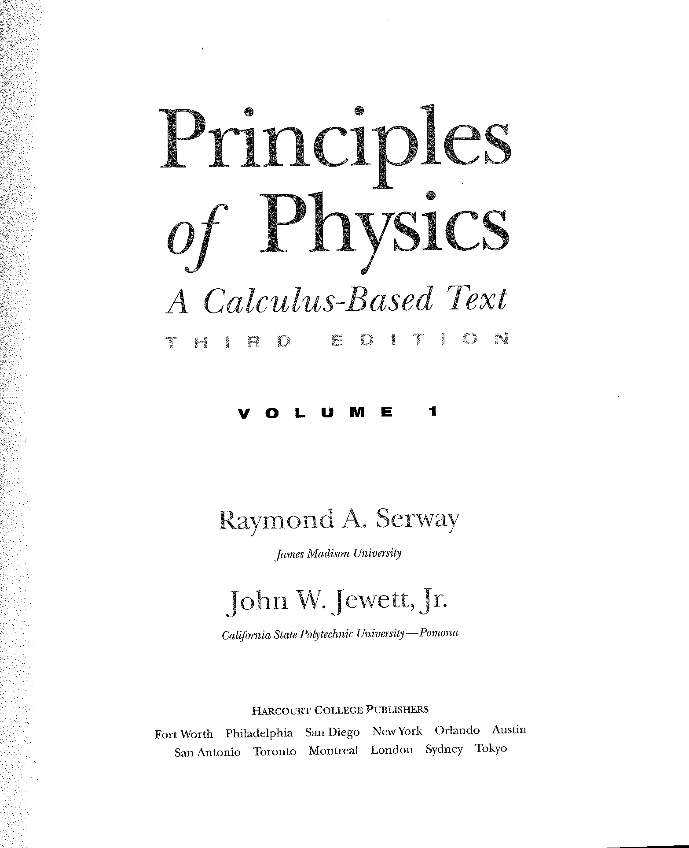

Slide 8
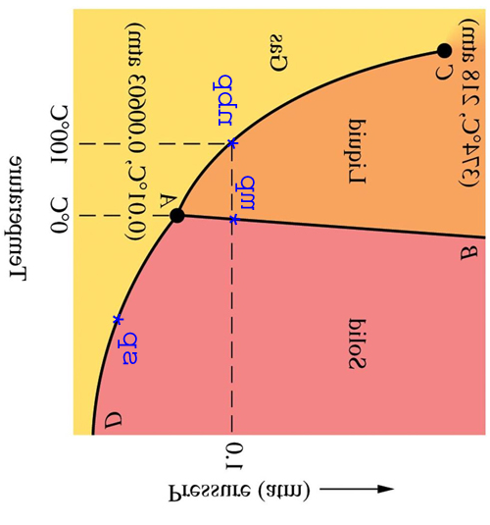
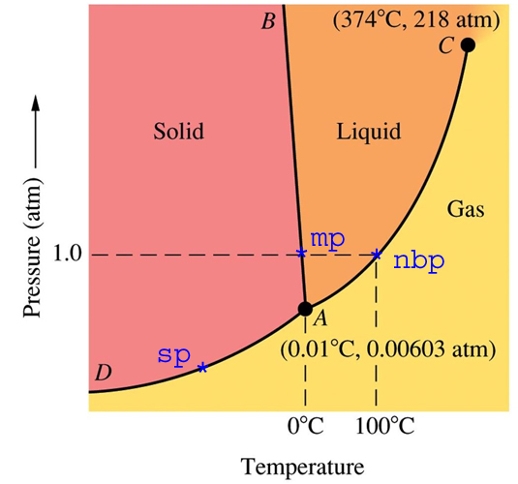
The Phase diagram (water)
Gas
Liquid
Temperature
T_{C}
Phase Transition:
T_{c} = 273K
Solid
Pressure

Slide 9
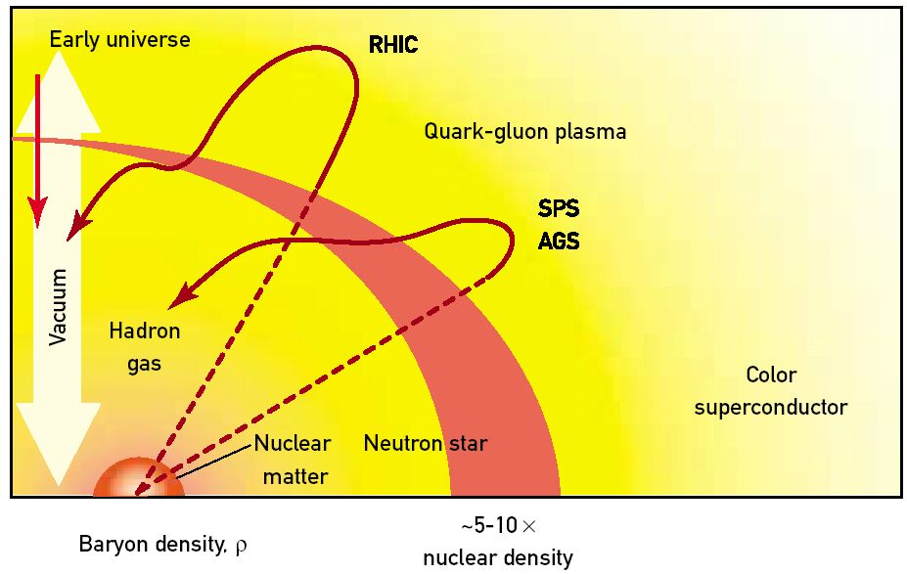
The Phase Diagram (Nuclear Matter)
T_{c}
Temperature
Phase Transition:
T_{c} = 190 MeV = 10¹²K ε ~ 0.6 GeV/fm³
Baryon Density

Slide 10
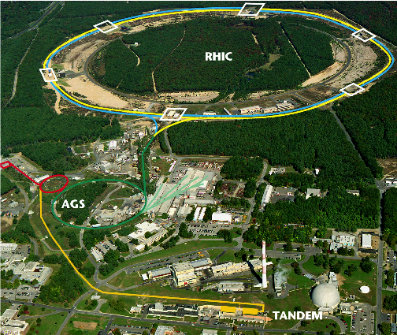
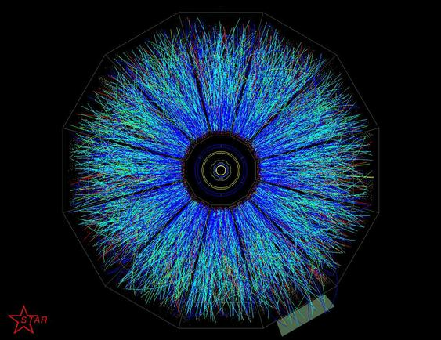
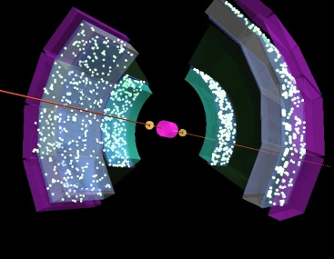

STAR
BNL-RHIC Facility
In the last couple of years: LHC
Collide Au + Au ions for maximum volume
  √s = 200 GeV/nucleon pair, p+p and d+A to compare

Slide 11

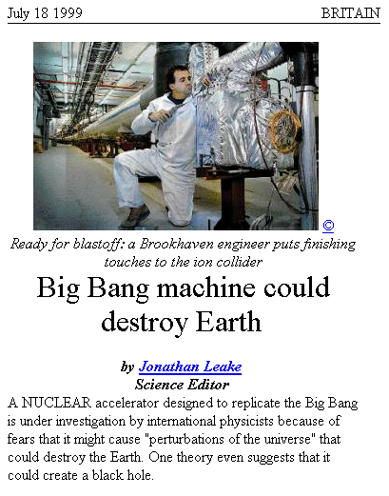
RHIC: A Doomsday Machine?

Slide 12
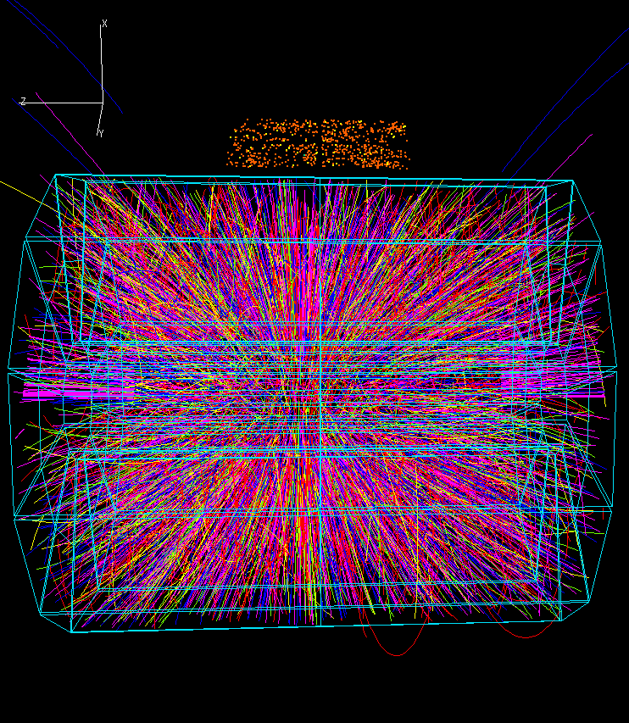
What does an Au+Au Collisions at 200 GeV Center of mass look like?

Slide 13
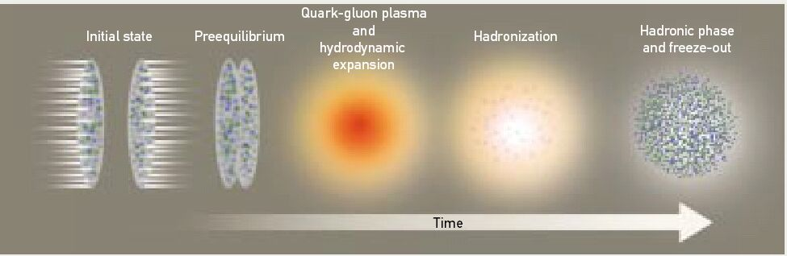
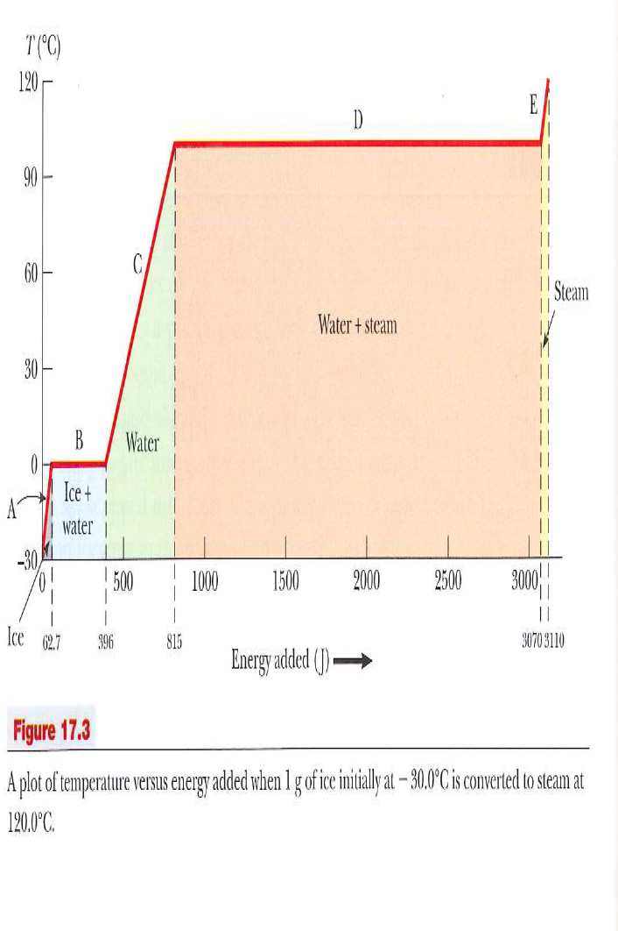
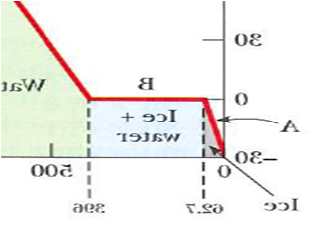
Stages of the Collision
transverse momentum p_{t}
T
Pure water
Relativistic Heavy Ion Collisions
  Lorenz contracted pancakes
  Pre-equilibrium < ~1fm/c ??
  QGP and hydrodynamic expansion ~ few fm/c ??
Pure
sQGP
time
T_{init}=?
Mixed phase
Tc ~ 190 MeV
τ₀
time

Slide 14
I.Temperature
units 1eV~10,000K
Use E=kT

Slide 15
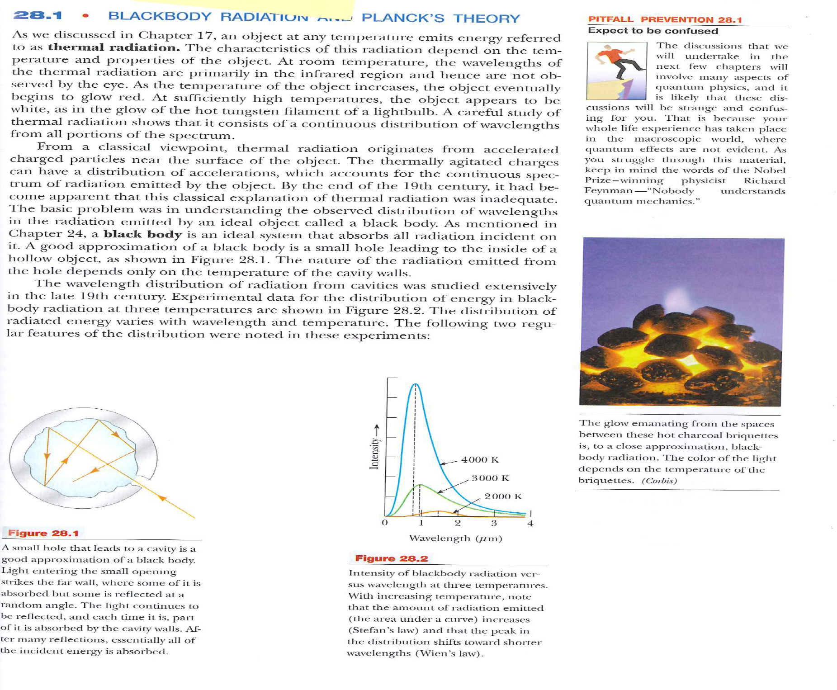
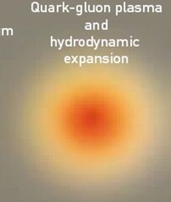
Measuring the Temperature: Black Body radiation (Serway)
photons
How do you
Measure T?
photons
Photon energy(wavelength) spectrum gives temperature

Slide 16
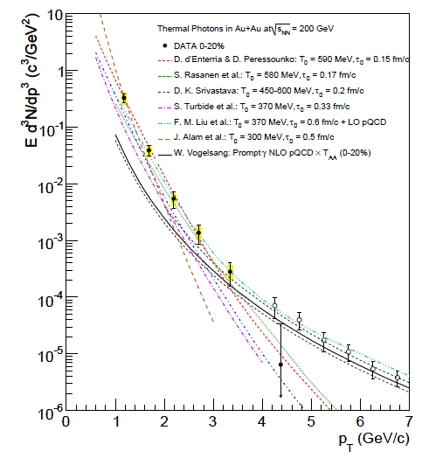

Thermal photons - Temperature from the data
Make a measure of low p_{T} photons (black body radiation)
Do a fit to models
T~300 MeV depending on Model
Greater than T_{C}!
  Tc ~190 MeV
IT’S HOT ENOUGH !
Thermal
photons
Intensity
pQCD
Energy

Slide 17
II. Jet quenching and energy density

Slide 18
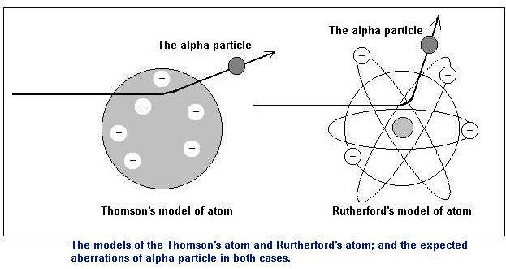
Remember Rutherford Scattering?
(Serway 29.1)

Slide 19
Hard Probes In Heavy Ion Collisions, aka Jet quenching
Beams of colored quarks
The experiment we would like to do – Rutherford Scattering of the QGP
Colorless
Hadrons
Colored
QGP
“hard” probes
  Formed in initial collision with high Q²
    penetrate hot and dense matter
    sensitive to state of hot and dense matter
      Energy loss by strong interaction
      ⇒ jet quenching
Hard parton
QGP and
hydrodynamic expansion
hadronic phase
and freeze-out
Softened
Jet
Look at single particle: π⁰
pre-equilibrium
hadronization

Slide 20
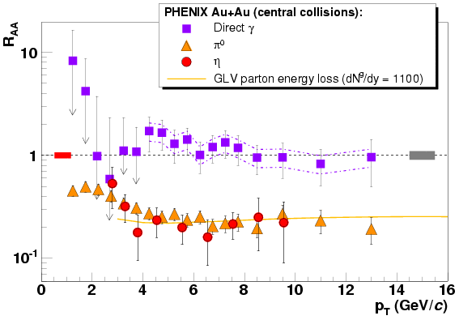

What is the energy density? “Jet quenching”
AuAu 200 GeV
direct photons scale as N_{coll}
π⁰ suppressed by 5!
➔High density
Colored matter
Direct γ
Calculations:
➔ε ~10-15 GeV/fm³
ε_{critial} ~0.6 GeV/fm3
0.2
π⁰
η
Energy density is high
Enough!
R_{AA}
Correction Au=197 nucleons

Slide 21
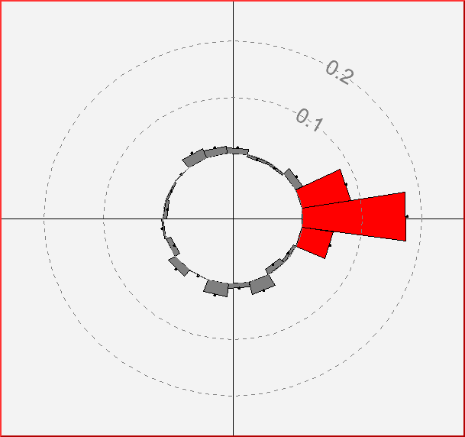
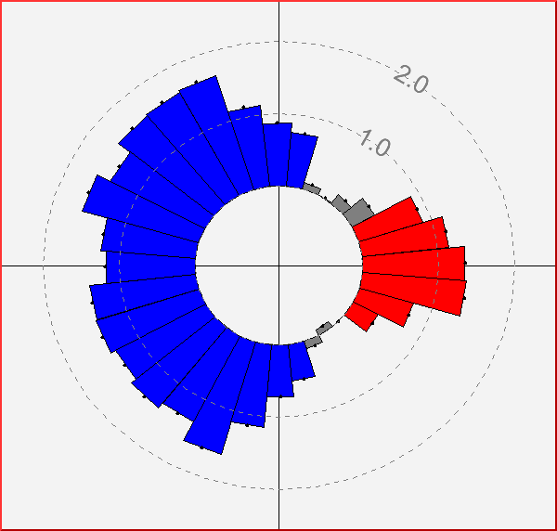
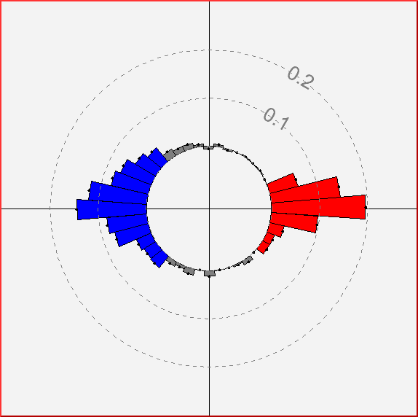
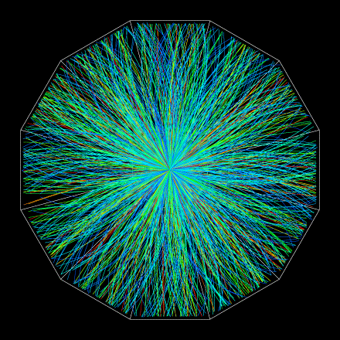
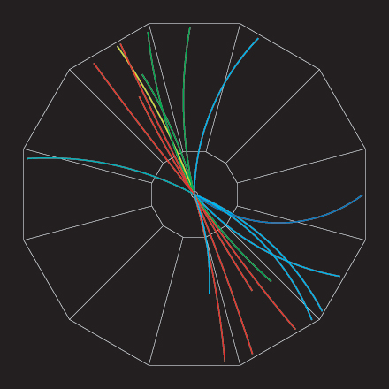
What about the “other” side?
Jet correlations in central Gold-Gold.
Away side jet disappears for particles p_{T} > 2 GeV
Jet correlations in central Gold-Gold.
Away side jet reappears for particles p_{T}>200 MeV
Jet correlations in proton-proton reactions.
Strong back-to-back peaks.
Leading hadrons
Medium
Azimuthal Angular Correlations

Slide 22
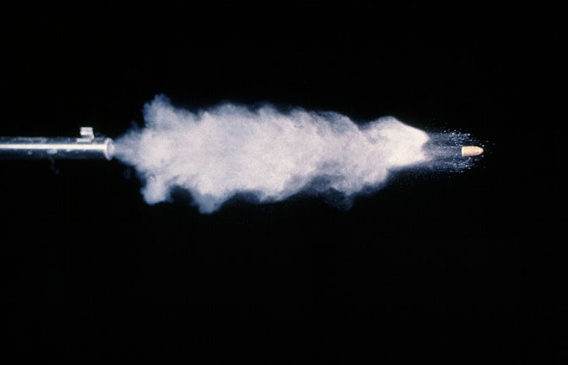

Almost complete extinction of jet
Is this remarkable? (me-2002)
right
“As you might know, the most interesting observation made at RHIC is that of the suppression of high-Energy hadrons, which may be an indication of jet quenching.
This is a remarkable effect. It is as if a bullet fired from a 22 rifle were stopped by a piece of tissue paper (actually by weight, the tissue paper would stop a bullet with 1000x the kinetic energy of an ordinary 22 bullet. Is this interesting? Just as a physical phenomena, it certainly seems to me to be quite extraordinary. The stuff that is being created - presumably a QGP is about the most viscous stuff on earth”.
dead wrong

Slide 23
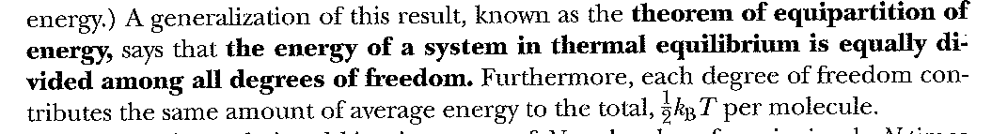
Now that we have the Temperature and Energy density… (Serway again)
Degrees of Freedom! (something about what it is…)
Monotonic Gas (3 degrees of freedom) E=3/2 nRT
Diatomic Gas (3+2=5 degrees of freedom) E=5/2nRT

Slide 24
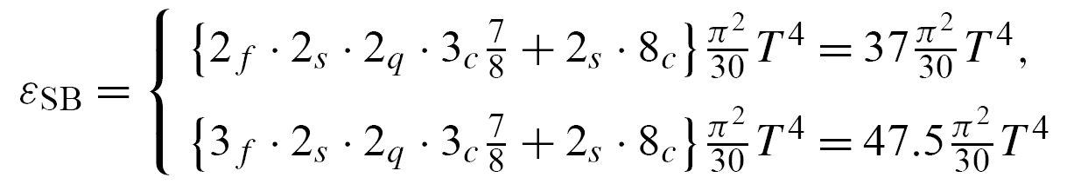
a first guess: Degrees of Freedom
Can we melt the hadrons and liberate quark and gluon degrees of freedom?
Energy density for “g”
massless d.o.f. (bosons)
Stefan Boltzmann law (Serway 17.10)
Hadronic Matter: quarks and gluons confined
For T ~ 200 MeV, 3 pions with spin=0
Quark Gluon Plasma:
8 gluons;
2 light quark flavors, antiquarks,
2 spins, 3 colors
d.o.f=37!

Slide 25
NDOF? a Sanity check - data
Regular stuff
“QGP”
good… But we really have no idea what the DOF really are

Slide 26
III. Viscosity

Slide 27
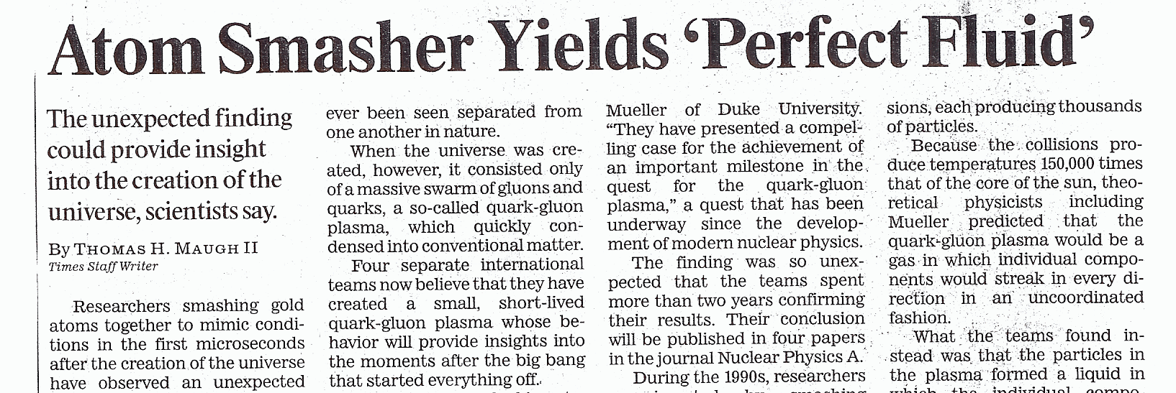

Flow, Hydrodynamics, Viscosity,
Perfect Fluids….
Los Angles Times – May 2005
?
YUK!
WHAT?!
and String Theory

Slide 28
Fluids: Ask Feynman ( from Feynman Lecture Vol II)
The subject of the flow of fluids, and particularly of water, fascinates everybody….we watch streams, waterfalls, and whirlpools, and we are fascinated by this substance which seems almost alive relative to solids. ….
The subject of the flow of fluids, and particularly of water, fascinates everybody….
Surely you’re
joking
Mr. Feynman

Slide 29
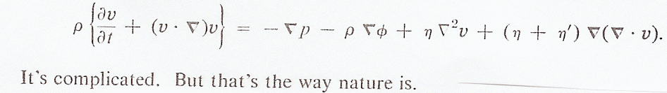
Viscosity and the equation of fluid flow
ρ=density of fluid
φ=potential (e.g. gravitational-think mgh)
v=velocity of fluid element
p=pressure
Bernoulli
Sheer Viscocity
[
]

Slide 30

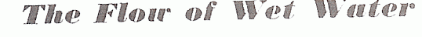
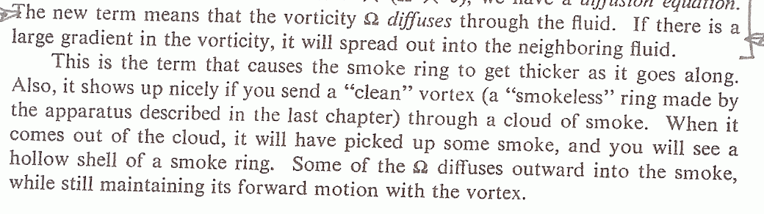
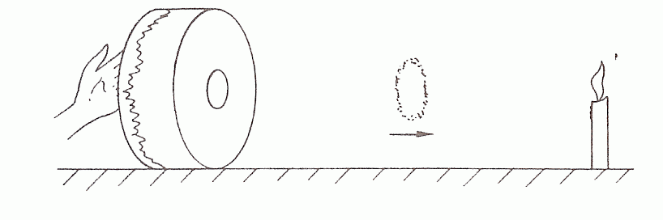

[
]
Non-ZERO Viscosity
smoke ring diffuses
smoke ring dissipates

Slide 31
[
]
ZERO Viscosity
does not diffuse
smoke ring keeps its shape
Viscosity
dissipates momentum
note: you actually need viscosity to get the smoke ring started

Slide 32
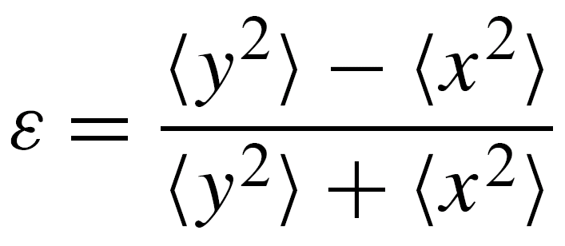
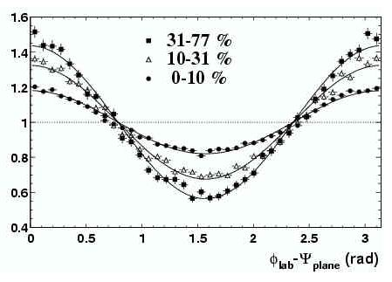

Measuring viscosity
Flow: A collective effect
p_{y}
φ
pressure
p_{x}
z
y
x
Coordinate space:
initial asymmetry
Momentum space:
final asymmetry
  dn/dφ ~ 1 + 2 v₂(p_{T}) cos (2 φ) + ...
  Initial spatial anisotropy converted into momentum anisotropy.
  Efficiency of conversion depends on the properties of the medium.

Slide 33
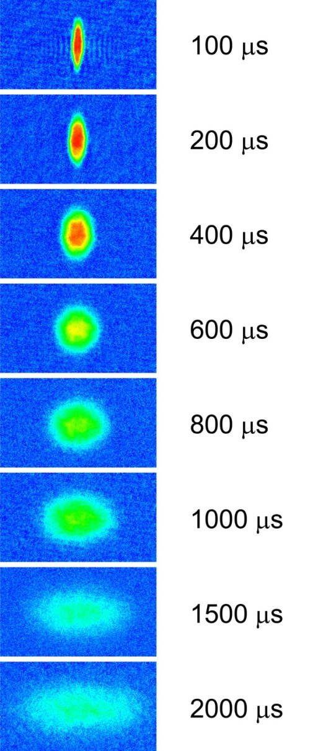
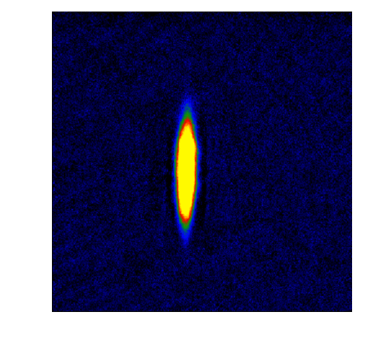
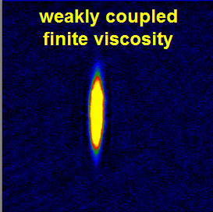
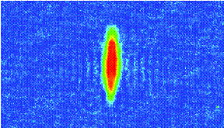
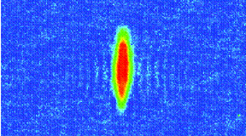
Anisotropic Flow
Conversion of spatial anisotropy to momentum anisotropy depends on viscosity
Same phenomena observed in gases of strongly interacting atoms (Li6)
M. Gehm, et al
Science 298 2179 (2002)
weakly coupled
finite viscosity
strongly coupled
viscosity=0
The RHIC fluid behaves like this,
that is, viscocity~0

Slide 34
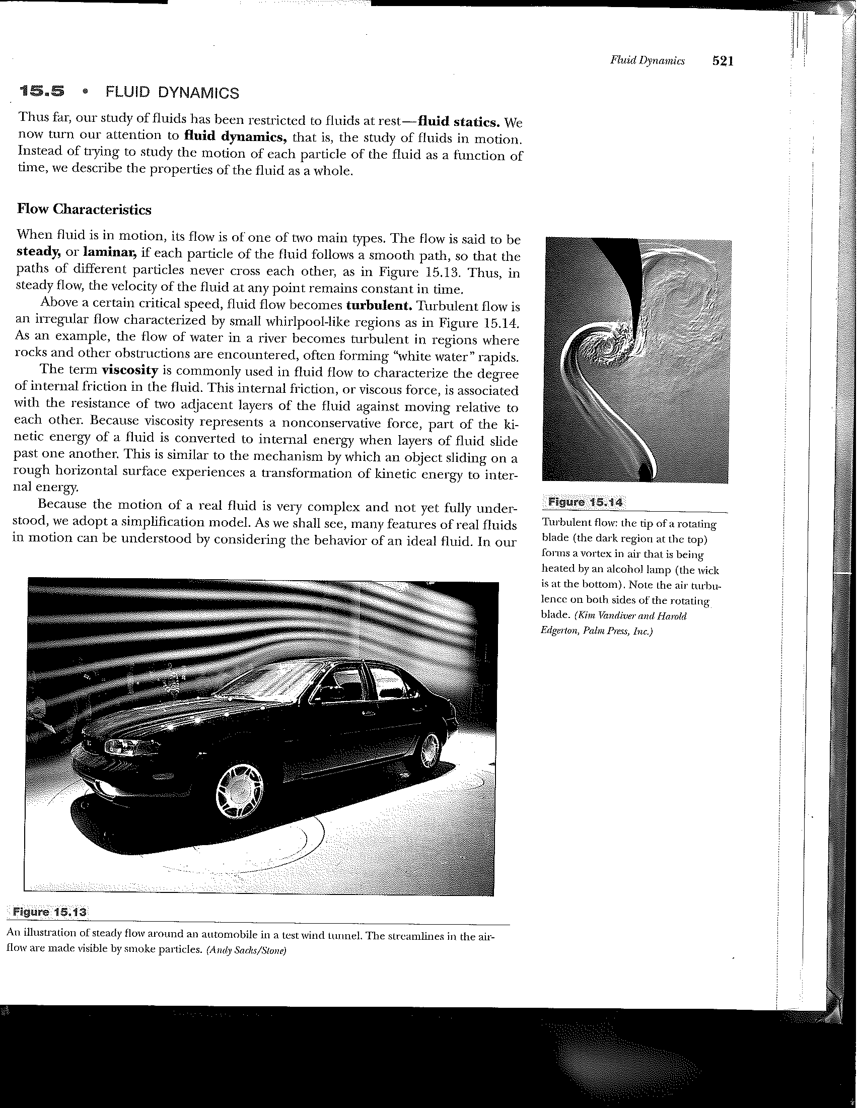
Viscocity: Serway again
Weakly coupled
➔large viscosity
Strongly coupled
➔zero viscosity

Slide 35
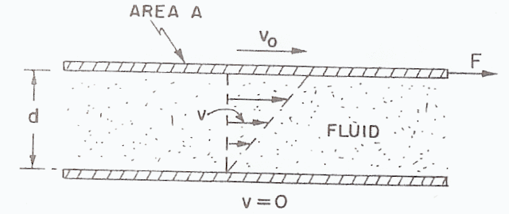

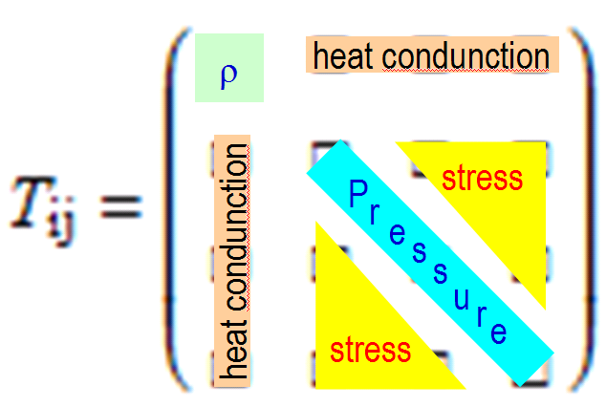
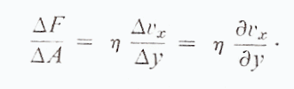
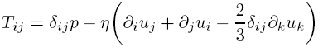


Calculating the viscosity (from Feynman)
y
Bigger F/A → larger viscosity
Larger viscosity →smaller v₀
Larger viscosity can act over larger d
Can we calculate the viscosity (η)?
BIG problem, QCD in our regime
is a strongly coupled theory
Perturbative techniques do NOT work
x
energy momentum
stress tensor
Einstein field eqn

Slide 36
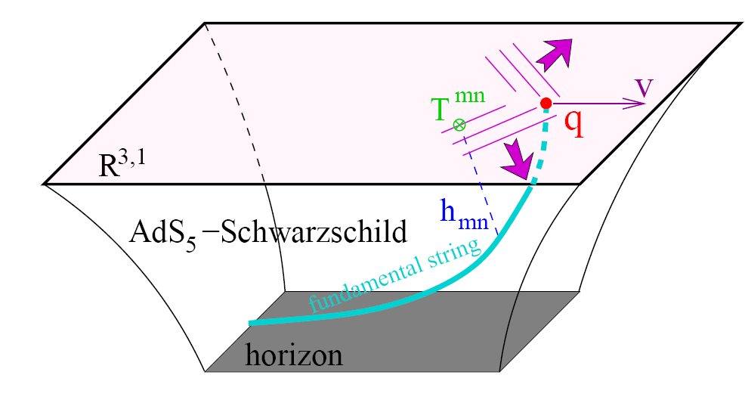
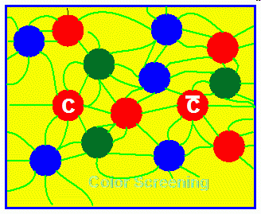

To the rescue!
String theory: Extra Dimensions
“QCD” strong coupling
Complicated
4d
Boundary
(we live here)
dual
5d bulk theory
z
Possibility to solve a strongly coupled theory! (for the first time??)

Slide 37

An Analogy
What is this??
Chessmen – a knight, bishop, king
You’re kidding!
Hmm... lets think. Its in 2D
dual
In 3D – Its easy to see
Its a Hologram

Slide 38



using gauge-string duality
=4 SYM
“QCD”
strong
coupling
Gravity
dual
Gravity
“QCD” strong coupling
Policastro, Son,
Starinets hep-th 0104066
“The key observation… is that the right hand side of the Kubo formula is known to be proportional to the classical absorption cross section of gravitons by black holes.”
σ(0)=area of black hole horizon

Slide 39
finishing it up: we want η/s (s=entropy)
Entropy
black hole “branes””
Entropy
=4 SYM
“QCD”
⬄
Entropy
black hole
Bekenstetein, Hawking
Area of black
hole horizon
=
=σ(0)
In our
Units
We had
This is believed to be a universal lower bound for a wide class of
Gauge theories with a gravity dual
k=8.6 E -5 eV/K
Kovtun, Son, Starinets hep-th 0405231

Slide 40

Extracting η/s from Data
STAR “non-flow” subtracted
V₂ Percent
Lo and behold
best fit
η/s ~0.08 = 1/4π
Phys.Rev.C78:034915 (2008)

Slide 41

sQGP – the most perfect fluid?
lowest viscosity
possible?
viscosity bound?
helium
nitrogen
water

Slide 42
viscocity~0, i.e. A Perfect Fluid?
water
nitrogen
See “A Viscosity Bound Conjecture”,
P. Kovtun, D.T. Son, A.O. Starinets, hep-th/0405231
  THE SHEAR VISCOSITY OF STRONGLY COUPLED N=4 SUPERSYMMETRIC YANG-MILLS PLASMA., G. Policastro, D.T. Son , A.O. Starinets, Phys.Rev.Lett.87:081601,2001 hep-th/0104066
lowest viscosity
possible?
helium
viscosity bound?
RHIC
Meyer Lattice: η/s = 0.134 (33)
arXiv:0704.1801
]

Slide 43
Some conclusions/thoughts
Observations
  T_{i} ~ 300 MeV > T_{critical}
  enormous stopping power
    energy density ~ 15 GeV/fm³ > critical energy density
  Strong flow signal
    viscosity/entropy density ~ 1/4π
    Perfect fluid
the stuff we are making at RHIC – sQGP
  Strongly Interacting Quark-Gluon-Plasma
  Interesting new connection
    String Theory and extra dimensions

