Slide 1
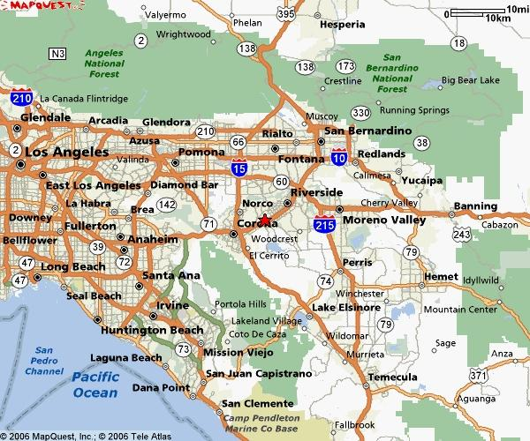

Undergraduate Research in the Community
Samantha L. Wilson
Coordinator of Undergraduate Research in the Community
Office of the Vice Provost,
Undergraduate Academic Programs
University of California, Riverside
321G Surge
951-827-7739 Office Phone
samantha.wilson@ucr.edu

Slide 2

What is “research in the community”?
Research in the community is challenging and responsible academic action that creates new knowledge by engaging with the community and cultivating one’s own sense of
critical consciousness.

Slide 3

Research in the Community IS…
Faculty-mentored
Collaborative
Reflective/dialogical (Group meetings)
Hands-on (Off-campus)
Upper division and credit-bearing (190 Series Units)
Academically challenging, personally meaningful
Independent or group/team work
Research in the Community is NOT…
Community service, volunteer work or an internship
Easy academic credit

Slide 4
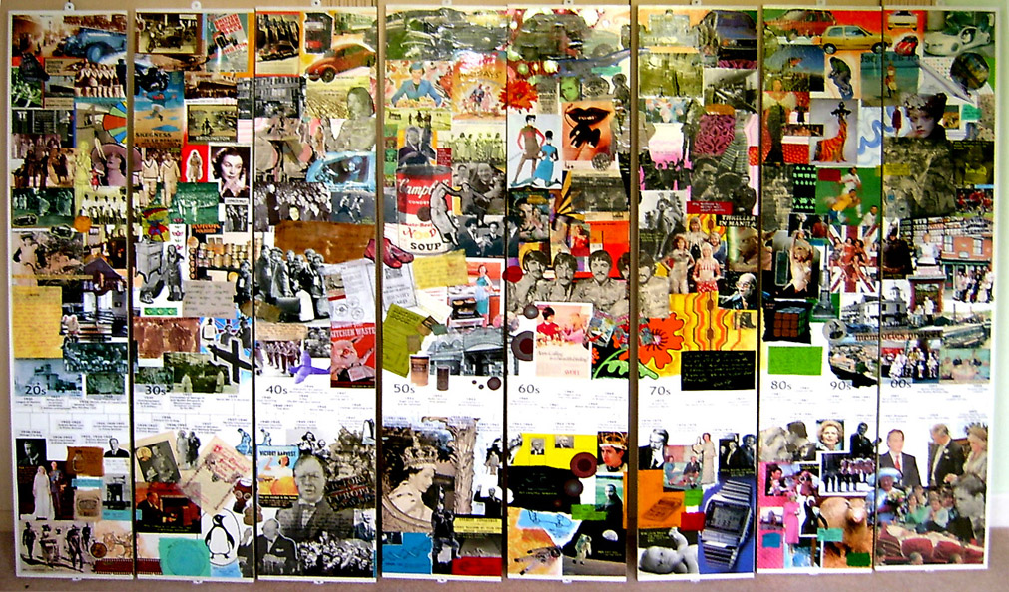
Sample proposals and initiatives currently available…
Nonprofit grant writing, fundraising and marketing
Development of local peace-keeping teams
Assessment and engaging of issues around homelessness, foreclosures, food shelter usage in Riverside due to economic downturn
Website development
Translation and bilingual curriculum development
Community organizing and campaigns
Women’s organizing and networking on-campus to off-campus
Retention, success, and recruitment of first generation students in local high schools to college and university
Roles in leadership and planning on regional nonprofit boards

Slide 5
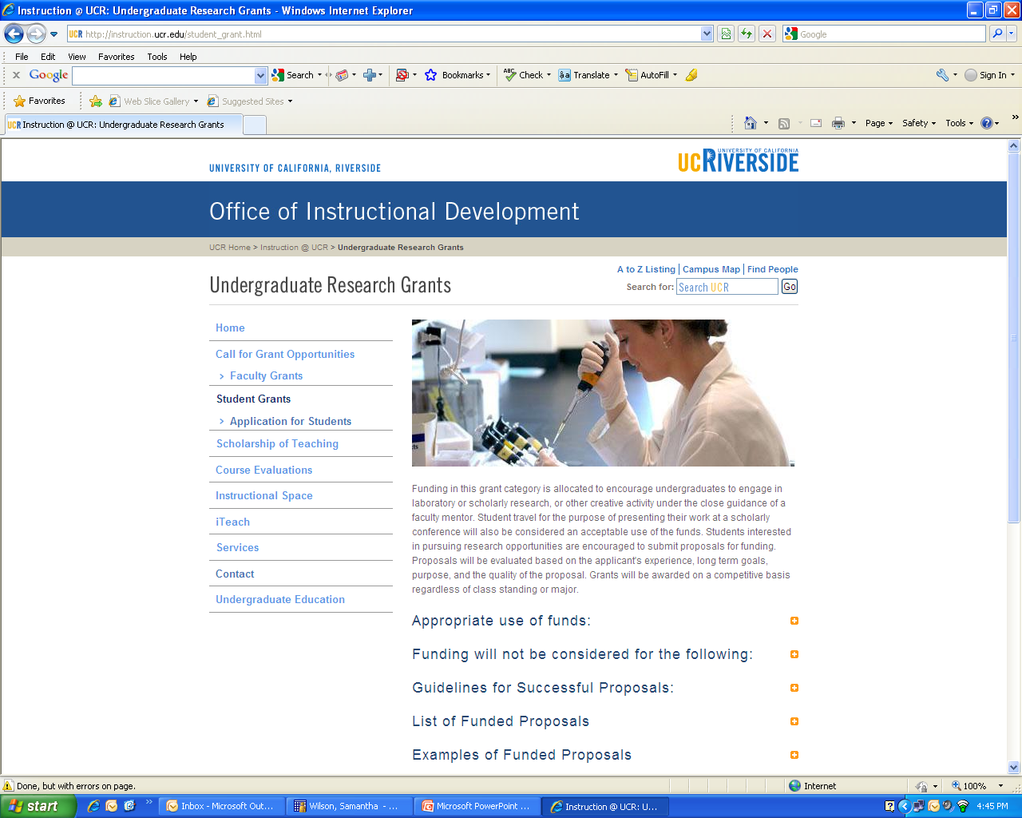
Project Funding
instruction.ucr.edu

Slide 6
Interested?
Samantha L. Wilson
Coordinator of Undergraduate Research in the Community
Office of the Vice Provost,
Undergraduate Academic Programs
University of California, Riverside
321G Surge
(Third floor, across from UNLH same building as Learning Center)
Office Hours: Tues and Wed, 3-5PM
951-827-7739 Office Phone
samantha.wilson@ucr.edu

