Slide 1
Firm Complexity and Post-Earnings-Announcement Drift by Barinov, Park, Yıldızhan
University of California, Riverside
Yonsei University
University of Georgia
December 8, 2018

Slide 2
Overview
We show that the post-earnings-announcement drift is stronger for conglomerates than single-segment firms

Slide 3
Overview
We show that the post-earnings-announcement drift is stronger for conglomerates than single-segment firms
Conglomerates on average are larger so it is unlikely for limits-to-arbitrage to drive the results

Slide 4
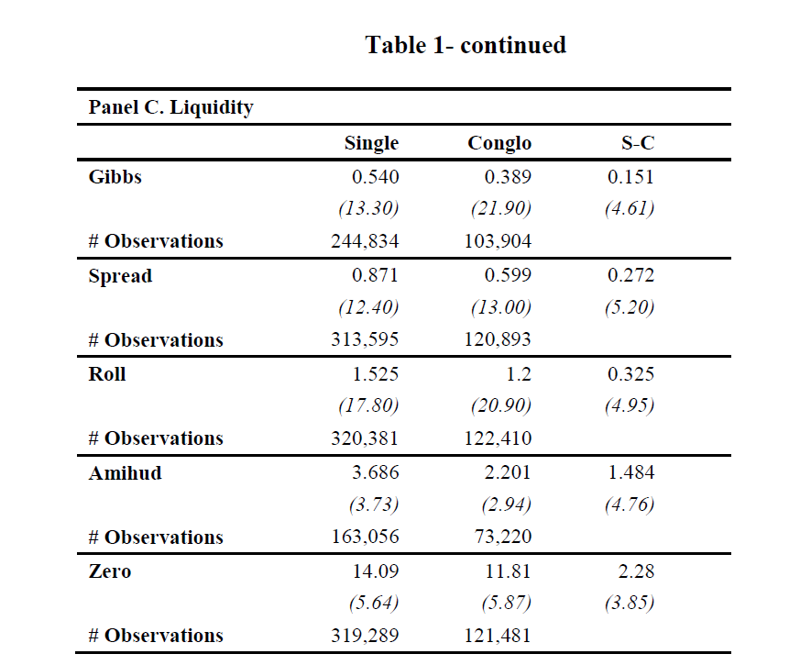
Overview

Slide 5
Overview
We show that the post-earnings-announcement drift is stronger for conglomerates than single-segment firms
Conglomerates on average are larger so it is unlikely for limits-to-arbitrage to drive the results
We hypothesize that conglomerates’ more complicated business models slow information processing about them

Slide 6
Don’t we already know this?
Gilson, Healy, Noe, and Palepu (2001) find that focus-increasing spin-offs lead to improved analyst forecast accuracy
due to reduction in analysts’ task complexity (Clement 1999)
and better facilitation of information transfers by analysts with industry expertise (Hilary and Shen 2013)
So what’s news?

Slide 7
Not clear due to sample selection
Krishnaswami and Subramaniam (1999) suggest that conglomerates that choose to break-up are those that are subject to the most severe information dissemination problems
Krishnaswami and Subramaniam (1999) report that the average forecast error of a conglomerate that breaks up is four times that of a similar conglomerate that doesn’t break up

Slide 8
And conflicting results from earlier
Thomas (2002) studies the impact of conglomeration on analyst forecast errors over the 1986-1995 time period and finds that conglomerates (single-segment firms) have lower (larger) analyst forecast errors on average in his sample
This finding could be attributable to the short time period he studies or due to his list of controls

Slide 9
Organizational structure and the firm’s information environment: Reloaded
Findings in Thomas (2002) are counter-intuitive and Gilson et al. (2001) and the literature that studies spin offs suffer form sample selection biases
We need to study the broad cross-section of firms including those that do stay as conglomerates in a longer time-series

Slide 10
Conglomerates and Information Processing
Unconditionally, conglomerates are much larger than single-segment firms and thus have more institutional ownership and analyst coverage with more accurate forecasts about them

Slide 11
Conglomerates and Information Processing
Unconditionally, conglomerates are much larger than single-segment firms and thus have more institutional ownership and analyst coverage with more accurate forecasts about them
Controlling for size alone reverses this finding

Slide 12
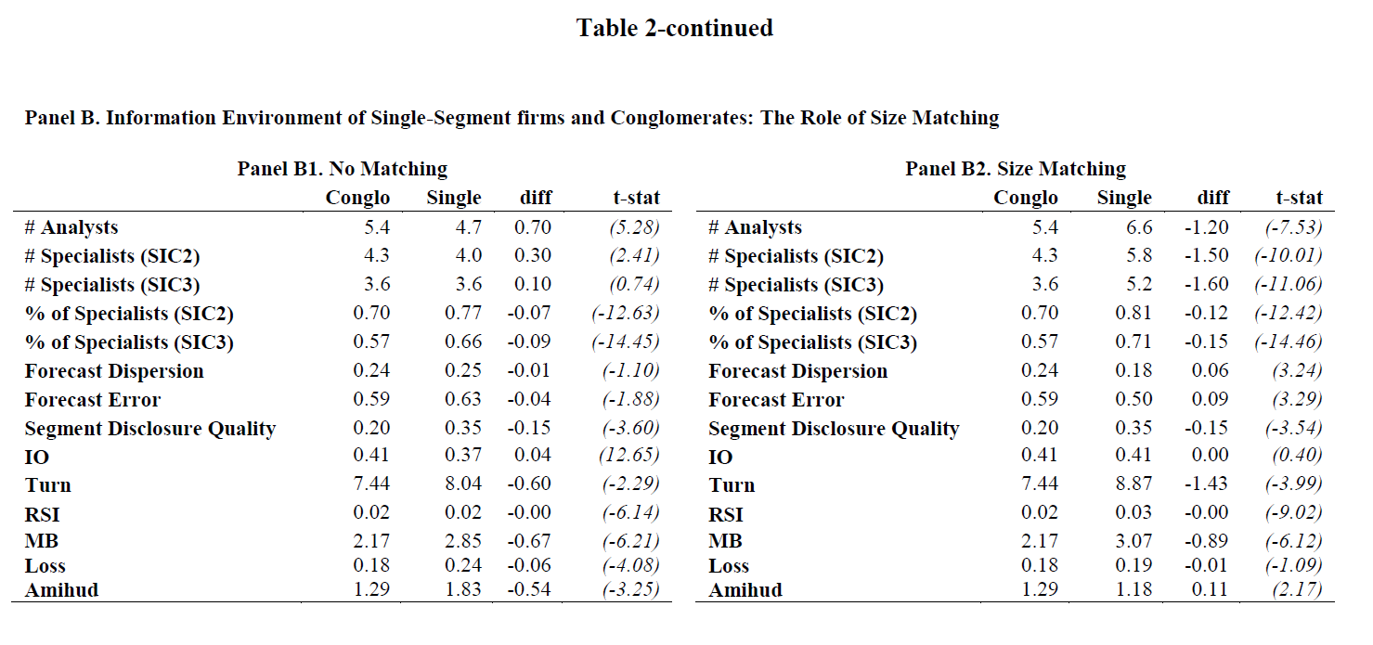
Conglomerates and Information Processing

Slide 13
Conglomerates and Information Processing
Unconditionally, conglomerates are much larger than single-segment firms and thus have more institutional ownership and analyst coverage with more accurate forecasts about them
Controlling for size alone reverses this finding
Further analyses suggest that investors prefer not to deal with conglomerates if a similar single-segment firm is available

Slide 14
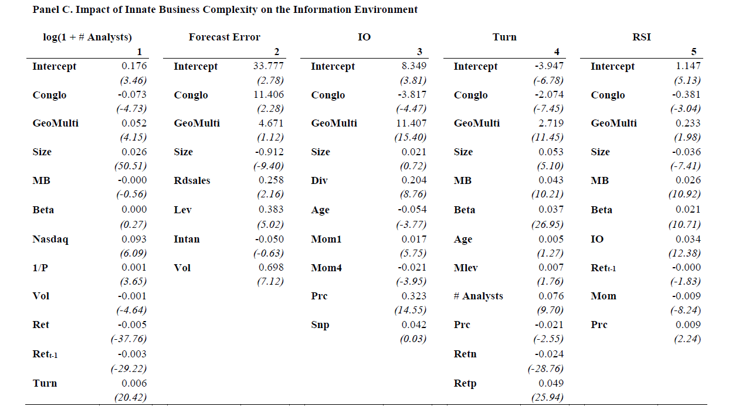
Conglomerates and Information Processing
Geographic and innate business complexity are distinct

Slide 15
Conglomerates and Information Processing
Unconditionally, conglomerates are much larger than single-segment firms and thus have more institutional ownership and analyst coverage with more accurate forecasts about them
Controlling for size alone reverses this finding
Further analyses suggest that investors prefer not to deal with conglomerates if a similar single-segment firm is available
This indicates that complex organizational structures impede information processing

Slide 16
Business Complexity should lead to larger PEAD
Firms with greater innate business complexity (conglomerates) should have larger PEADs compared to simpler firms (single-segment firms) due to the slower and more difficult price discovery process.
We expect an under-reaction to earnings related news for conglomerates compared to single segment firms, followed by a larger drift

Slide 17
Why use organizational form as a measure of business complexity, why not something else?
The literature on PEAD largely focuses on how capital market characteristics such as information production by the firm, information uncertainty and the information processing of investors can offer an understanding of PEAD
Although firm complexity could be measured by one or more of the above proxies, these proxies could also be affected by factors other than innate business complexity such as managers’ actions to distort information.
The number of segments (conglomerate status) which is an input-based measure, as opposed to output based measures like noisy earnings and return volatility, can thus help us to better identify innate business complexity.

Slide 18
Organizational form and Predictable Returns, Cohen and Lou (2012)
Our paper builds on the arguments used by Cohen and Lou (2012) and expands on their analyses by investigating how investors process a large chunk of information about the complicated firm itself (earnings announcement), instead of looking at how they process the information about the industries the firm operates in
The challenges faced by the investors in our setup, i.e., disaggregating the earnings announcement into information about different segments, are different from the challenges investors face in the Cohen and Lou analysis, i.e., aggregating industry-level news about segments to revise the valuation of the conglomerate.

Slide 19
Fama-MacBeth Regressions
Fama-MacBeth regressions allow for comparing the magnitude of PEAD for the same level of earnings surprise for single-segment firms and conglomerates
“Stronger PEAD for complicated firms" means that if one takes a conglomerate and a single-segment firm with the same level of SUE, the conglomerate will have stronger PEAD
The result is not only academic as can also be traded

Slide 20
Measures of Complexity used in regressions
Conglomerate dummy (Conglo) is 1 if the firm has multiple segments, 0 otherwise
Concentration (Complexity) equals to 1-HHI, HHI is based on segment sales: HHI=1 is a single-segment firm, HHI=0.5 - a firm with two equal segments, HHI=0.1 is a firm with ten equal segments
Number of segments (based on 2-digit SIC codes)

Slide 21
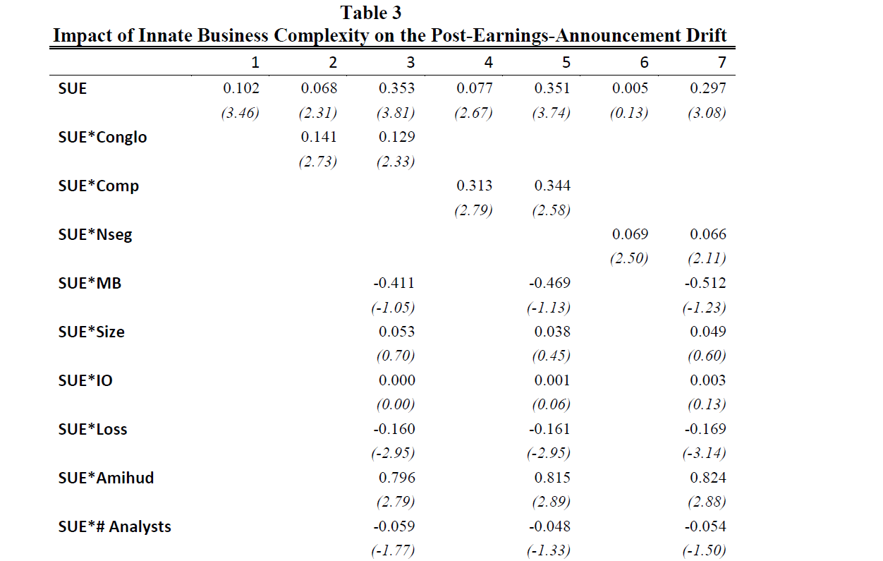
Main Results

Slide 22
Implications of Fama-MacBeth regressions
In the second column, the interaction of the conglomerate dummy and SUE is highly significant and suggests that for conglomerates PEAD is 3.86% (1.96%) greater per three months than it is for single-segment firms when we estimate the difference in the PEADs by using the SUE differential between the 97.5th and the 2.5th (95th and 5th) SUE percentiles vs single segment firms’ 2.79% (1.42%)
Interpretations are similar using Comp and Nseg, i.e PEAD for a representative complex firm is about twice as the PEAD for a single segment firm

Slide 23
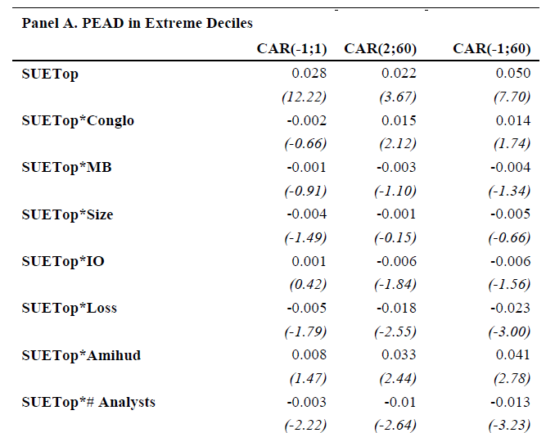
Fama-MacBeth Regressions with Extreme Deciles
Conglomerates don’t seem to contain more news per SUE yet definitely have tradable higher PEADs vs. single-segment firms

Slide 24
Delayed Response Ratios
Significantly higher percentage of earnings related information processing takes in the drift period for conglomerates compared to single-segment firms (59.1% vs 44.5%) when trading the High-Low hedge SUE portfolio documenting the under-reaction to earnings related news for firms with higher innate business complexity
Investors have more difficulty processing earnings related information regarding conglomerates and information processing takes more time for complex firms

Slide 25
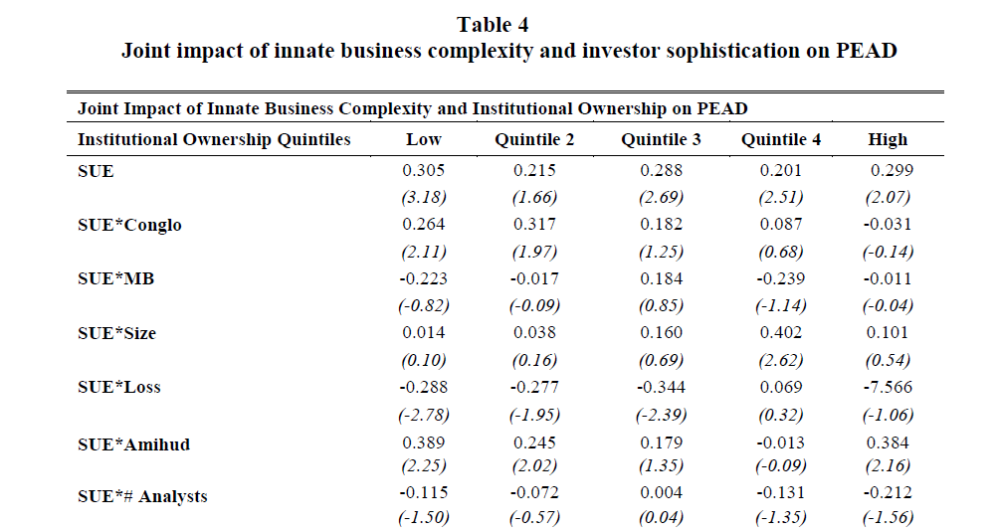
Institutional Ownership matters

Slide 26
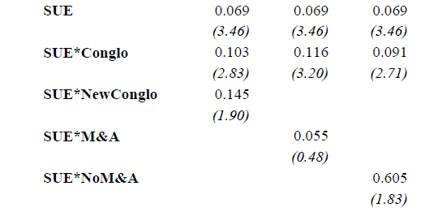
New Conglomerates
New conglomerates have PEADs about 4 times that of single-segment firms and twice as large as existing conglomerates (4.7%, 2.3%, 1.3% using SUE at 95/5 percentiles and twice of these numbers using SUE at 97.5/2.5)
Investors are surprised by the organizational change in the new conglomerate.

Slide 27
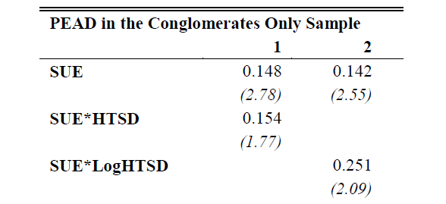
Cross-sectional variation among conglomerates
We measure dispersion in segment growth rates as in Hirshleifer and Teoh (2003) and find that as a conglomerate gets more difficult to understand PEAD increases

Slide 28
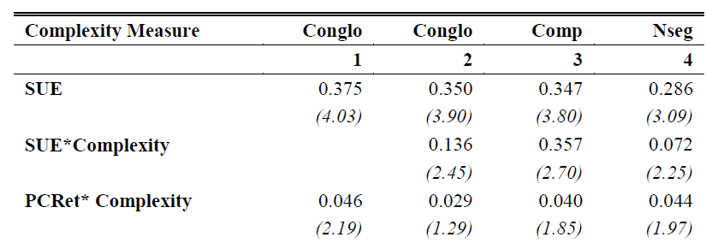
Checking for overlap with Cohen and Lou (2012)
Our main result still holds after controlling for Pseudo Conglomerate returns suggesting stronger PEADs by conglomerates is a separate phenomenon that has no overlap with the findings of Cohen and Lou (2012)

Slide 29
Controlling for alternative explanations of PEAD
Our results are also robust to alternative explanations of PEAD such as
the impact of (DRESP) analyst responsiveness (Zhang 2008)
the impact of (EarnVol) ex-ante earnings volatility on earnings persistence (Cao and Narayanamoorthy 2012)
(EP): the time-varying nature of earnings persistence (Chen 2013)
(FOG): the impact of disclosure complexity (Miller 2010, You and Zhang 2009, Feldman, Govindaraj, Livnat, and Segal 2010, Lehavy, Li and Merkley 2011, Lee 2012)

Slide 30
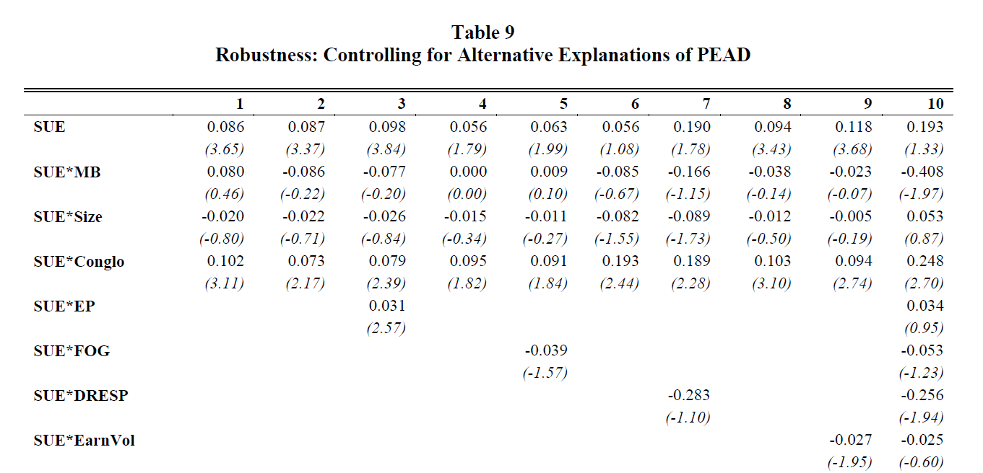
Controlling for alternative explanations

Slide 31
Controlling for alternative explanations of PEAD
Furthermore, our findings can’t be explained by limits-to-arbitrage, in particular
by the impact of institutional ownership (Bartov, Radhakrishnan and Krinsky 2000);
arbitrage risk (Mendenhall 2004);
transactions costs (Ng, Rusticus, and Verdi 2008)
or liquidity on PEAD (Sadka 2006) since conglomerates have lower limits-to-arbitrage

Slide 32
Alternative SUE measures and CARs

Slide 33
Conclusions
Conglomerates have PEADs that are twice as large as single-segment firms and have significantly larger delayed response ratios
This effect can’t be explained by limits-to-arbitrage
We attribute this result to investors having more difficulty processing earnings related information regarding conglomerates as multi-segment firms have significantly more complicated business models and are understood less

