Slide 1
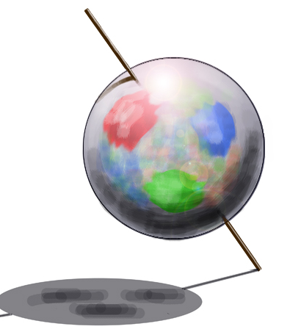
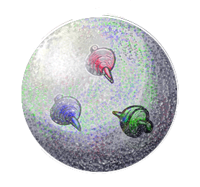
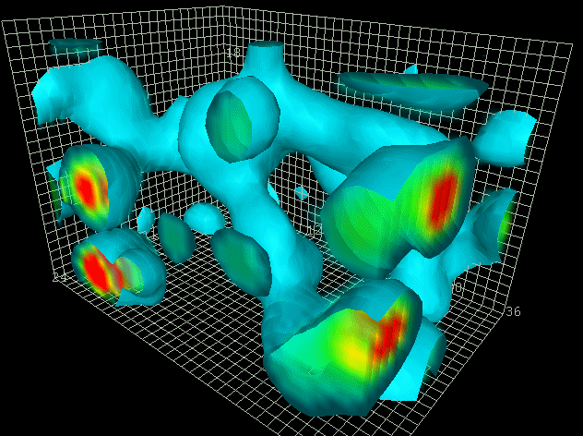
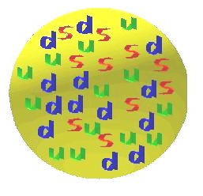
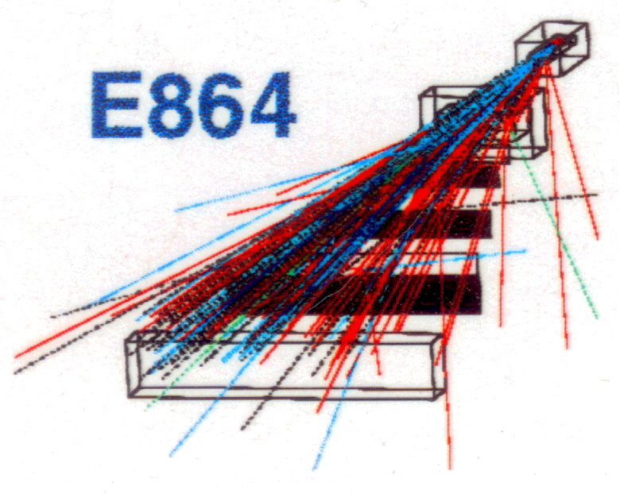
What makes up the spin of the proton?
Search for strange quark matter
Kenneth N. Barish
UC Riverside
Teachers Academy
June 26, 2012

Slide 2
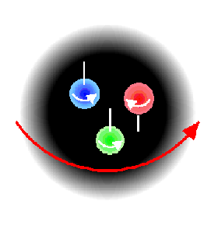
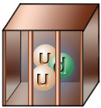
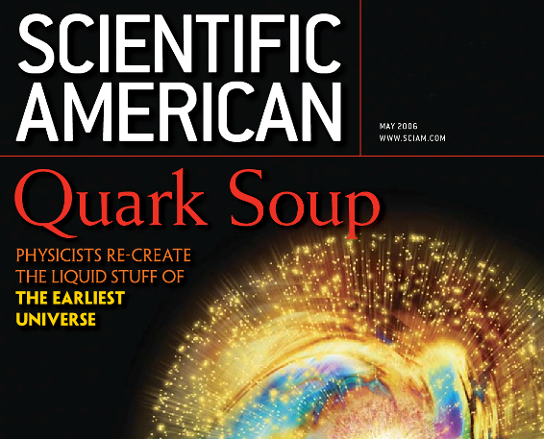
Questions RHIC hopes to address
  What makes up the spin of the proton?
    ⇒ polarized proton collisions
  Why are quarks confined inside protons?
    polarized proton & heavy-ion collisions
  What are the properties of hot/dense matter?
    ⇒ heavy-ion collisions

Slide 3
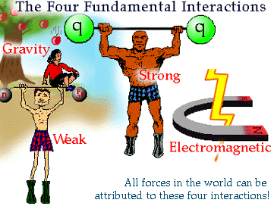
The Four Fundamental Forces in Nature
  Gravity
    Terrestrial & astronomic gravity
  Weak interaction
    Decays
  Electromagnetic Interaction
    Molecular bonds, stickiness, electric motors, magnetic compasses
  Strong interaction
    The sun, atom bombs, nuclear energy
Interaction | Strength | Range | Mediator
Strong | 1 | Short | Gluon
Electromagnetic | 0.0073 | Long | Photon
Weak | 10⁻⁹ | Very Short | W, Z
Gravitational | 10⁻³⁸ | Long | Graviton

Slide 4
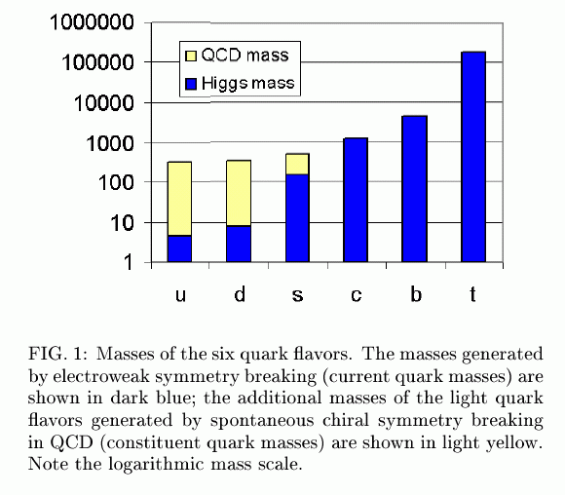
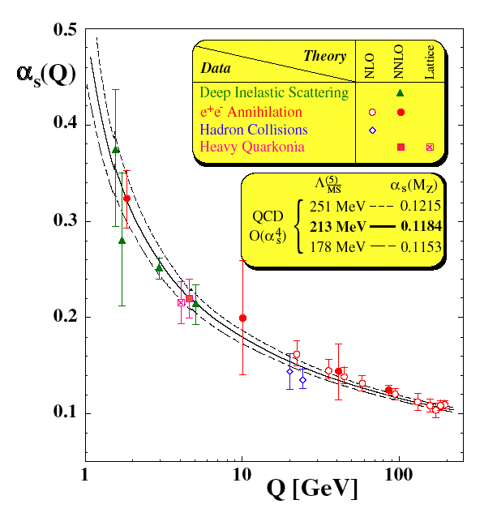



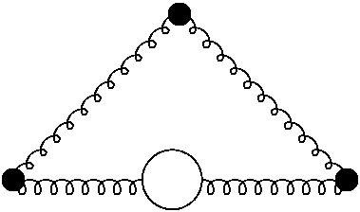
Quantum Chromodynamics
Theory of the strong interaction
  Part of the standard model
  Quarks as constituents, gluons as field quanta
Asymptotic freedom
  Interaction between quarks becomes weaker when they get close together and stronger if pulled apart!
Confinement
  Quarks carry color charge
  Only color neutral states exist “freely”
Chiral symmetry breaking
  Hadrons are much heavier than their constituents
David J. Gross
H. David Politzer
Frank Wilczek
T<T_{c}
Asymptotic Freedom
T>T_{c}
Infrared Slavery
Proton
0.2 fm 0.02 fm 0.002 fm
Notes:
Two of the non-perturbative phenomena of QCD that are not easily calculable:
(1) confinement – we don’t observe quarks and gluons as free particles. They are confined in hadrons. Shown here is a lattice QCD calculation. Three quarks on a lattice – see bound structure of the system. If raise temperature high enough these particles become quasi-free.
(2) Chiral symmetry breaking – reflected in fact hadrons much heavier htan constituents. QCD H p+e cloose to mass H. in QCD p u+d << mp

Slide 5

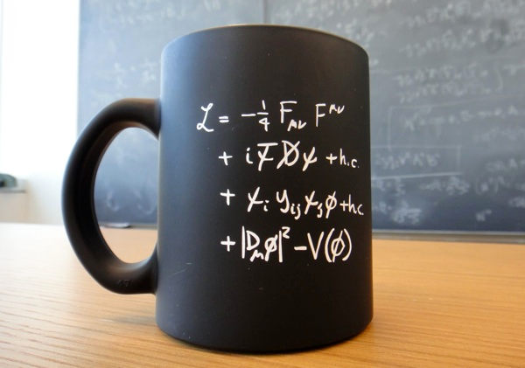
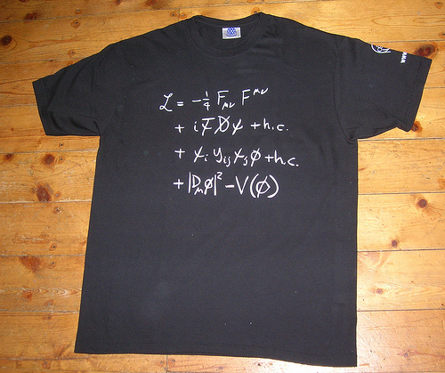
Quantum Chromodynamics
The QCD Lagrangian is known
But complicated …
Models can be built independent of the substructure of nucleons.

Slide 6
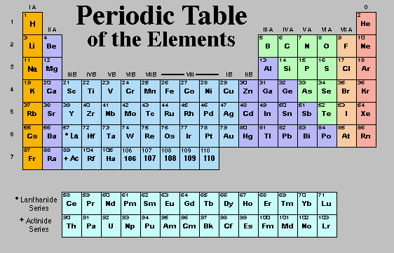
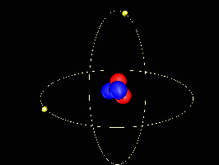
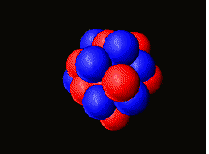
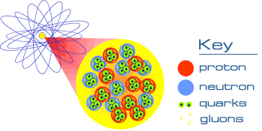
Start with the Basics
Helium Atom
Oxygen Nucleus

Slide 7
Atomic Nucleus
Atoms are usually electrically neutral
  They must have as many + charges as – charges
  Each electron must be matched by a + charge
At the center of an atom is its nucleus
  Extremely small (1/100,000th of the atom’s diameter)
  Contains most of the atom’s mass
  Also contains most of the atom’s potential energy
    Evidence is related to: E=mc²

Slide 8
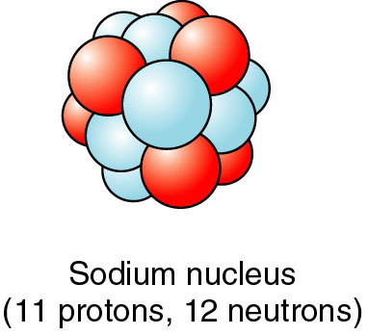
Structure of Nucleus
Nucleus contains two kinds of nucleons
  Protons are positively charged
  Neutrons are neutral
Two forces are active in a nucleus
  Electrostatic repulsion between protons
  Nuclear force attraction between touching nucleons
  At short distances, nuclear force is stronger than electric
  At long distances, electric force is stronger than nuclear
Nuclear physics studies nuclear components and forces, and many models can be built independent of the substructure of nucleons.

Slide 9
Structure of the Proton
See the whole proton
Momentum transfer
Q² = 0.1 GeV²
Wavelength l = h/p
See the quark substructure
Q² = 1.0 GeV²
See many partons (quarks and gluons)
Q² = 20.0 GeV²

Slide 10
Simple Quark Model
Proton
(charge=+1, spin=1/2)
Neutron
(charge=0, spin=1/2)
2 up quarks (+2/3 charge)
1 down quark (-1/3 charge)
1 up quarks (+2/3 charge)
2 down quark (-1/3 charge)
Up Down Strange Charm Bottom Top

Slide 11
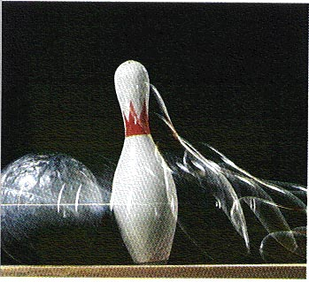

What is “spin”?
For translational motion we define linear momentum
  Conservation of linear momentum is a powerful tool
For rotational motion we define angular momentum
  Angular momentum is conserved
  Earth has both “orbital” (sun) and “spin” (axis) angular momentum
  Point particles (no constituents) can have the intrinsic property of “spin”
  “spin” is a “quantum number”

Slide 12


What carries the spin of the proton?

Slide 13
Spin asymmetries
Photo absorption:
Proton
Probe:
Does not conserve
angular momentum
Cross Section:
Proton and photon spin antiparallel:
quarks with spin parallel contribute
Proton and photon spin parallel:
quarks with spin anti-parallel contribute
Measure Double
Spin Asymmetry
Virtual photon Asymmetry

Slide 14
Proton and spin

Slide 15

Spin carried by quarks?
Expect asymmetries in measurements due to angular momentum conservation
Can use this measurement to extract spin carried by quarks within the proton
"spin crisis"

Slide 16

Resolution to crisis – gluons?
Proton

Slide 17
How can we probe experimentally?
Polarized proton collisions

Slide 18
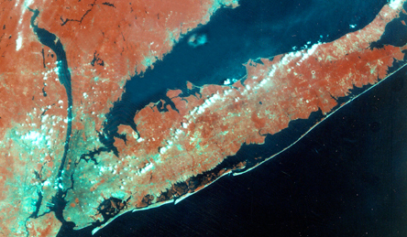

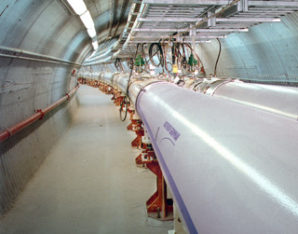
Relativistic Heavy Ion Collider
New accelerator at the Brookhaven National Laboratory - 4km circumference
100+100 GeV² Au-Au collisions
spin polarized proton collisions at 500 GeV

Slide 19
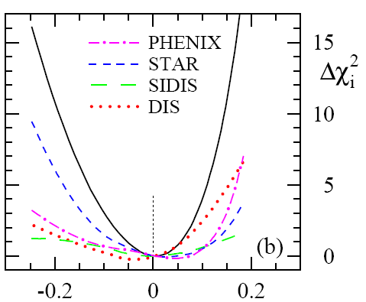
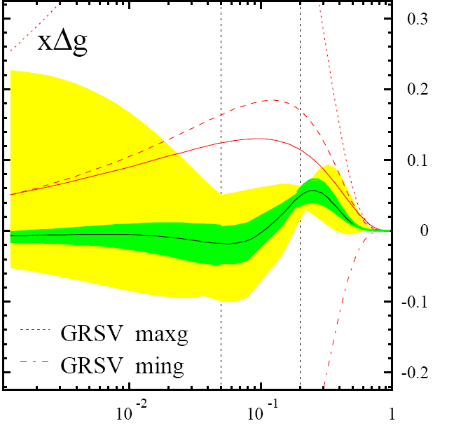
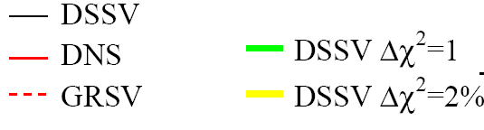
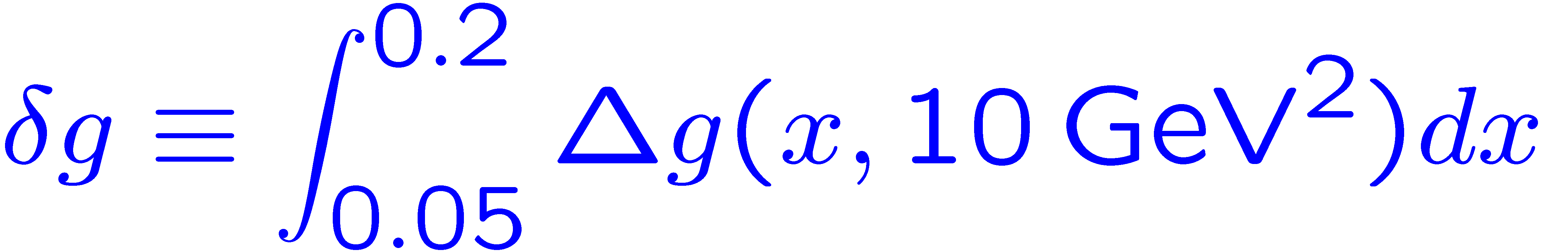
Status of Results for ΔG
x
small-x
0.001· x · 0.05
RHIC
range
0.05· x · 0.2
large-x
x ¸ 0.2

Slide 20
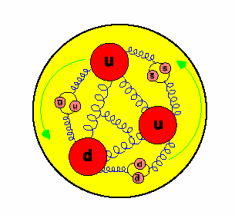
What makes up the spin of the proton?
as viewed with a high energy (short wavelength) probe
as viewed with a low energy (long wavelength) probe
3 valence quarks + gluons
+ virtual quark-anti-quark pairs
charge
momentum
mass
spin
3 valence quarks →
charge
momentum
mass
spin
u
?
u
?
d
gluon
spin
10⁻¹⁵ m
The spin structure of the
proton is still a mystery!
quark
spin
orbital
angular
mom.
Includes contributions from the quark sea

Slide 21
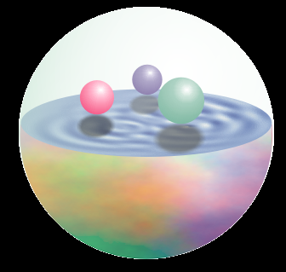
Probe quark sea with W’s
Neutrino n_{m}
Up
W+
μ⁺
Hi-momentum
Only left-handed quark and right-handed anti-quark will contribute.
Flavor is almost fixed.
Best suited for spin-flavor structure studies.
Anti-down
21
Notes:
21

Slide 22
RHIC has an exciting future
RHIC is an optimal facility to study the QCD!
We are just beginning to probe the spin structure of the proton.
Transverse spin will ultimately lead to a 3D picture of the nucleon.
We have created a novel form of matter (sQGP)

Slide 23


Brazil University of São Paulo, São Paulo
China Academia Sinica, Taipei, Taiwan
China Institute of Atomic Energy, Beijing
Peking University, Beijing
Czech Charles University, Prague,
Republic Czech Technical University, Prague, Czech Republic
Academy of Sciences of the Czech Republic, Prague
Finland University of Jyvaskyla, Jyvaskyla
France LPC, University de Clermont-Ferrand, Clermont-Ferrand
Dapnia, CEA Saclay, Gif-sur-Yvette
IPN-Orsay, Universite Paris Sud, CNRS-IN2P3, Orsay
LLR, Ecòle Polytechnique, CNRS-IN2P3, Palaiseau
SUBATECH, Ecòle des Mines at Nantes, Nantes
Germany University of Münster, Münster
Hungary Central Research Institute for Physics (KFKI), Budapest
Debrecen University, Debrecen
Eötvös Loránd University (ELTE), Budapest
India Banaras Hindu University, Banaras
Bhabha Atomic Research Centre, Bombay
Israel Weizmann Institute, Rehovot
Japan Center for Nuclear Study, University of Tokyo, Tokyo
Hiroshima University, Higashi-Hiroshima
KEK, Institute for High Energy Physics, Tsukuba
Kyoto University, Kyoto
Nagasaki Institute of Applied Science, Nagasaki
RIKEN, Institute for Physical and Chemical Research, Wako
RIKEN-BNL Research Center, Upton, NY
Rikkyo University, Toshima, Tokyo
Tokyo Institute of Technology, Tokyo
University of Tsukuba, Tsukuba
Waseda University, Tokyo
S. Korea Cyclotron Application Laboratory, KAERI, Seoul
Ewha Womans University, Seoul, Korea
Kangnung National University, Kangnung
Korea University, Seoul
Myong Ji University, Yongin City
System Electronics Laboratory, Seoul Nat. University, Seoul
Yonsei University, Seoul
Russia Institute of High Energy Physics, Protovino
Joint Institute for Nuclear Research, Dubna
Kurchatov Institute, Moscow
PNPI, St. Petersburg Nuclear Physics Institute, St. Petersburg
Lomonosoy Moscow State University, Moscow
St. Petersburg State Technical University, St. Petersburg
Sweden Lund University, Lund
14 Countries; 68 Institutions; 550 Participants
USA Abilene Christian University, Abilene, TX
Brookhaven National Laboratory, Upton, NY
University of California - Riverside, Riverside, CA
University of Colorado, Boulder, CO
Columbia University, Nevis Laboratories, Irvington, NY
Florida Institute of Technology, FL
Florida State University, Tallahassee, FL
Georgia State University, Atlanta, GA
University of Illinois Urbana Champaign, IL
Iowa State University and Ames Laboratory, Ames, IA
Los Alamos National Laboratory, Los Alamos, NM
Lawrence Livermore National Laboratory, Livermore, CA
University of Maryland, College Park, MD
University of Massachusetts, Amherst, MA
Muhlenberg College, Allentown, PA
University of New Mexico, Albuquerque, NM
New Mexico State University, Las Cruces, NM
Dept. of Chemistry, Stony Brook Univ., Stony Brook, NY
Dept. Phys. and Astronomy, Stony Brook Univ., Stony Brook, NY
Oak Ridge National Laboratory, Oak Ridge, TN
University of Tennessee, Knoxville, TN
Vanderbilt University, Nashville, TN

